Slide 1
Organizational Behavior & Design
Team 3 Abhijit Valiathan
Balaji Katakam
Jayesh Mehta
Priyanka Bhandari
Sheshadri Talla

Slide 2
Agenda
Purpose of the External and Internal Assessments in the Strategic Planning process or in Organizational analysis
Best practices that make these assessments effective.
Mistakes that are made by leaders or organizations.
Questions for the discussion

Slide 3
Internal and External Assessments
Introduction
The Internal Assessment is an inventory of the strengths and weaknesses of the organization’s operations.
It includes a survey of human and physical resources, an analysis of the satisfaction of clients and stakeholders, and an assessment of the effectiveness of the Board and of the staff.
The result of an internal assessment reveals the strengths and weaknesses that confront the organization.
The External Assessment, or External Environmental Scan, is an inventory of the political, economic, social, and technological forces that influence the mission and goals of an organization, and how it functions.
It involves analysis of the current environment and the trends that may affect it.
It also includes an analysis of competitive and collaborative forces and agents.
The result of an external assessment reveals the opportunities and threats that confront the organization.
Priyanka Bhandari

Slide 4

Internal and External Assessments
Purpose
Need for External assessment:
1.Identification of strength, weakness ,opportunities and threats.
2.Optimum use of resources.
3.Survival and growth.
4.To plan long-term business strategy.
Need for Internal Assessment:
1.To determine strength and competency.
2.To evaluate competitive viability
3.To assess cost position and opportunity
Priyanka Bhandari

Slide 5
External Environmental Analysis
The process consists of 4 sequential steps:
Scanning: It includes general surveillance of all environmental factors and their interactions in order to
Identify early signals of possible environmental changes
Detect environmental change that is under way
Monitoring: It usually involves tracking the environmental trends, sequences of activities, or streams of activities.Generally 2 outcomes are presented:
A specific description of environmental trends and patterns to be forecasted.
Identification of trends for further monitoring and areas for further scanning.
Forecasting: It is concerned with developing plausible of direction, scope, and intensity of environmental change.It tried to layout the evolutionary path of anticipated change.
• Unlike the other two it is much focused and more deductive and complex activity .
Assessment: It involves identifying and evaluating how and why current projected environmental changes affect or will affect strategic management of organization and the frame and moves from understanding the environment-the focus of scanning monitoring forecasting to identifying what the understanding means for organization.
Priyanka Bhandari

Slide 6
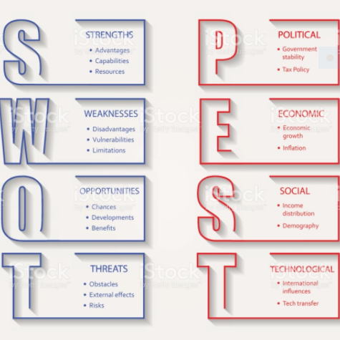
SWOT Analysis VS PEST Analysis (Tools)
Priyanka Bhandari

Slide 7
Internal Assessment
Internal Assessment is an exploration of your organization’s competency, cost position and competitive viability in the marketplace. Conducting an internal analysis often incorporates measures that provide useful information about your organization.
VRIO Is perfect for evaluation of the company’s resources. Once you know your resources you can better understand your competitive advantages or weaknesses. The VRIO considers for each type of the resource the following questions (called evaluation dimension) both for your company and for your competitors. The dimensions of VRIO are:
Value - How expensive is the resource and how easy is it to obtain on the market (purchase, lease, rent.)?
Rareness - How rare or limited is the resource?
Imitability - How difficult is it to imitate the resource?
Organization, respectively arrangement - Is the resource supported by any existing arrangements and can the organization use it properly?
Balaji Katakam

Slide 8
McKinsey’s 7-S Framework
McKinsey’s 7-S Framework is applicable to a wide variety of situations where an alignment perspective is useful. The goal of the model is to show how 7 elements of the company: Structure, Strategy, Skills, Staff, Style, Systems, and Shared values, can be aligned together to achieve effectiveness in a company. The key point of the model is that all the seven areas are interconnected and a change in one area requires change in the rest of a firm for it to function effectively. The model can be applied to many situations and is a valuable tool when organizational design is at question. The most common uses of the framework are:
To facilitate organizational change.
To help implement new strategy.
To identify how each area may change in a future.
To facilitate the merger of organizations
Balaji Katakam

Slide 9
Value Chain Analysis
Value Chain Analysis is a process where a firm identifies its primary and support activities that add value to its final product and then analyze these activities to reduce costs or increase differentiation.
The Advantages of Value Chain Analysis
1. A big advantage is that the value chain is a very flexible strategy tool for looking at your business, your competitors and the respective places in the industry’s value system.
2. The value chain analysis can be used to diagnose and create competitive advantages on both cost and differentiation.
The Disadvantages of Value Chain Analysis
1. Many people are familiar with the value chain, but few are experts in its use.
2. Business information systems are often not structured in a way to make it easy to get information for value chain analysis.
Balaji Katakam

Slide 10
Best Practices For Effective Organizational Analysis
Size and Growth: What are important and potentially important markets? What are their size and growth characteristics? What markets are declining? What are the driving forces behind sales trends?
Profitability: For each major market consider the following: Is this a business in which the average firm will make money? How intense is the competition among existing firms? Evaluate the threats from potential entrants and substitute products. What is the bargaining power of suppliers and customers? How attractive/profitable is the market now and in the future?
Cost Structure: What are the major cost and value-added components for various types of competitors?
Distribution Systems: What are the alternative channels of distribution? How are they changing?
Market Trends: What are the trends in the market?
Key Success Factors: What are the key success factors, assets and competencies needed to compete successfully? How will these change in the future?
Abhijit Valiathan

Slide 11
Best Practices For Effective Organizational Analysis
Environmental Analysis: An environmental analysis is the fourth dimension of the External Analysis. The interest is in environmental trends and events that have the potential to affect strategy. This analysis should identify such trends and events and estimate their likelihood and impact. When conducting this type of analysis, it is easy to get bogged down in an extensive, broad survey of trends. It is necessary to restrict the analysis to those areas relevant enough to have significant impact on strategy.
Internal Analysis: Understanding a business in depth is the goal of internal analysis. This analysis is based on resources and capabilities of the firm.
Resources: A good starting point to identify company resources is to look at tangible, intangible and human resources
Abhijit Valiathan

Slide 12
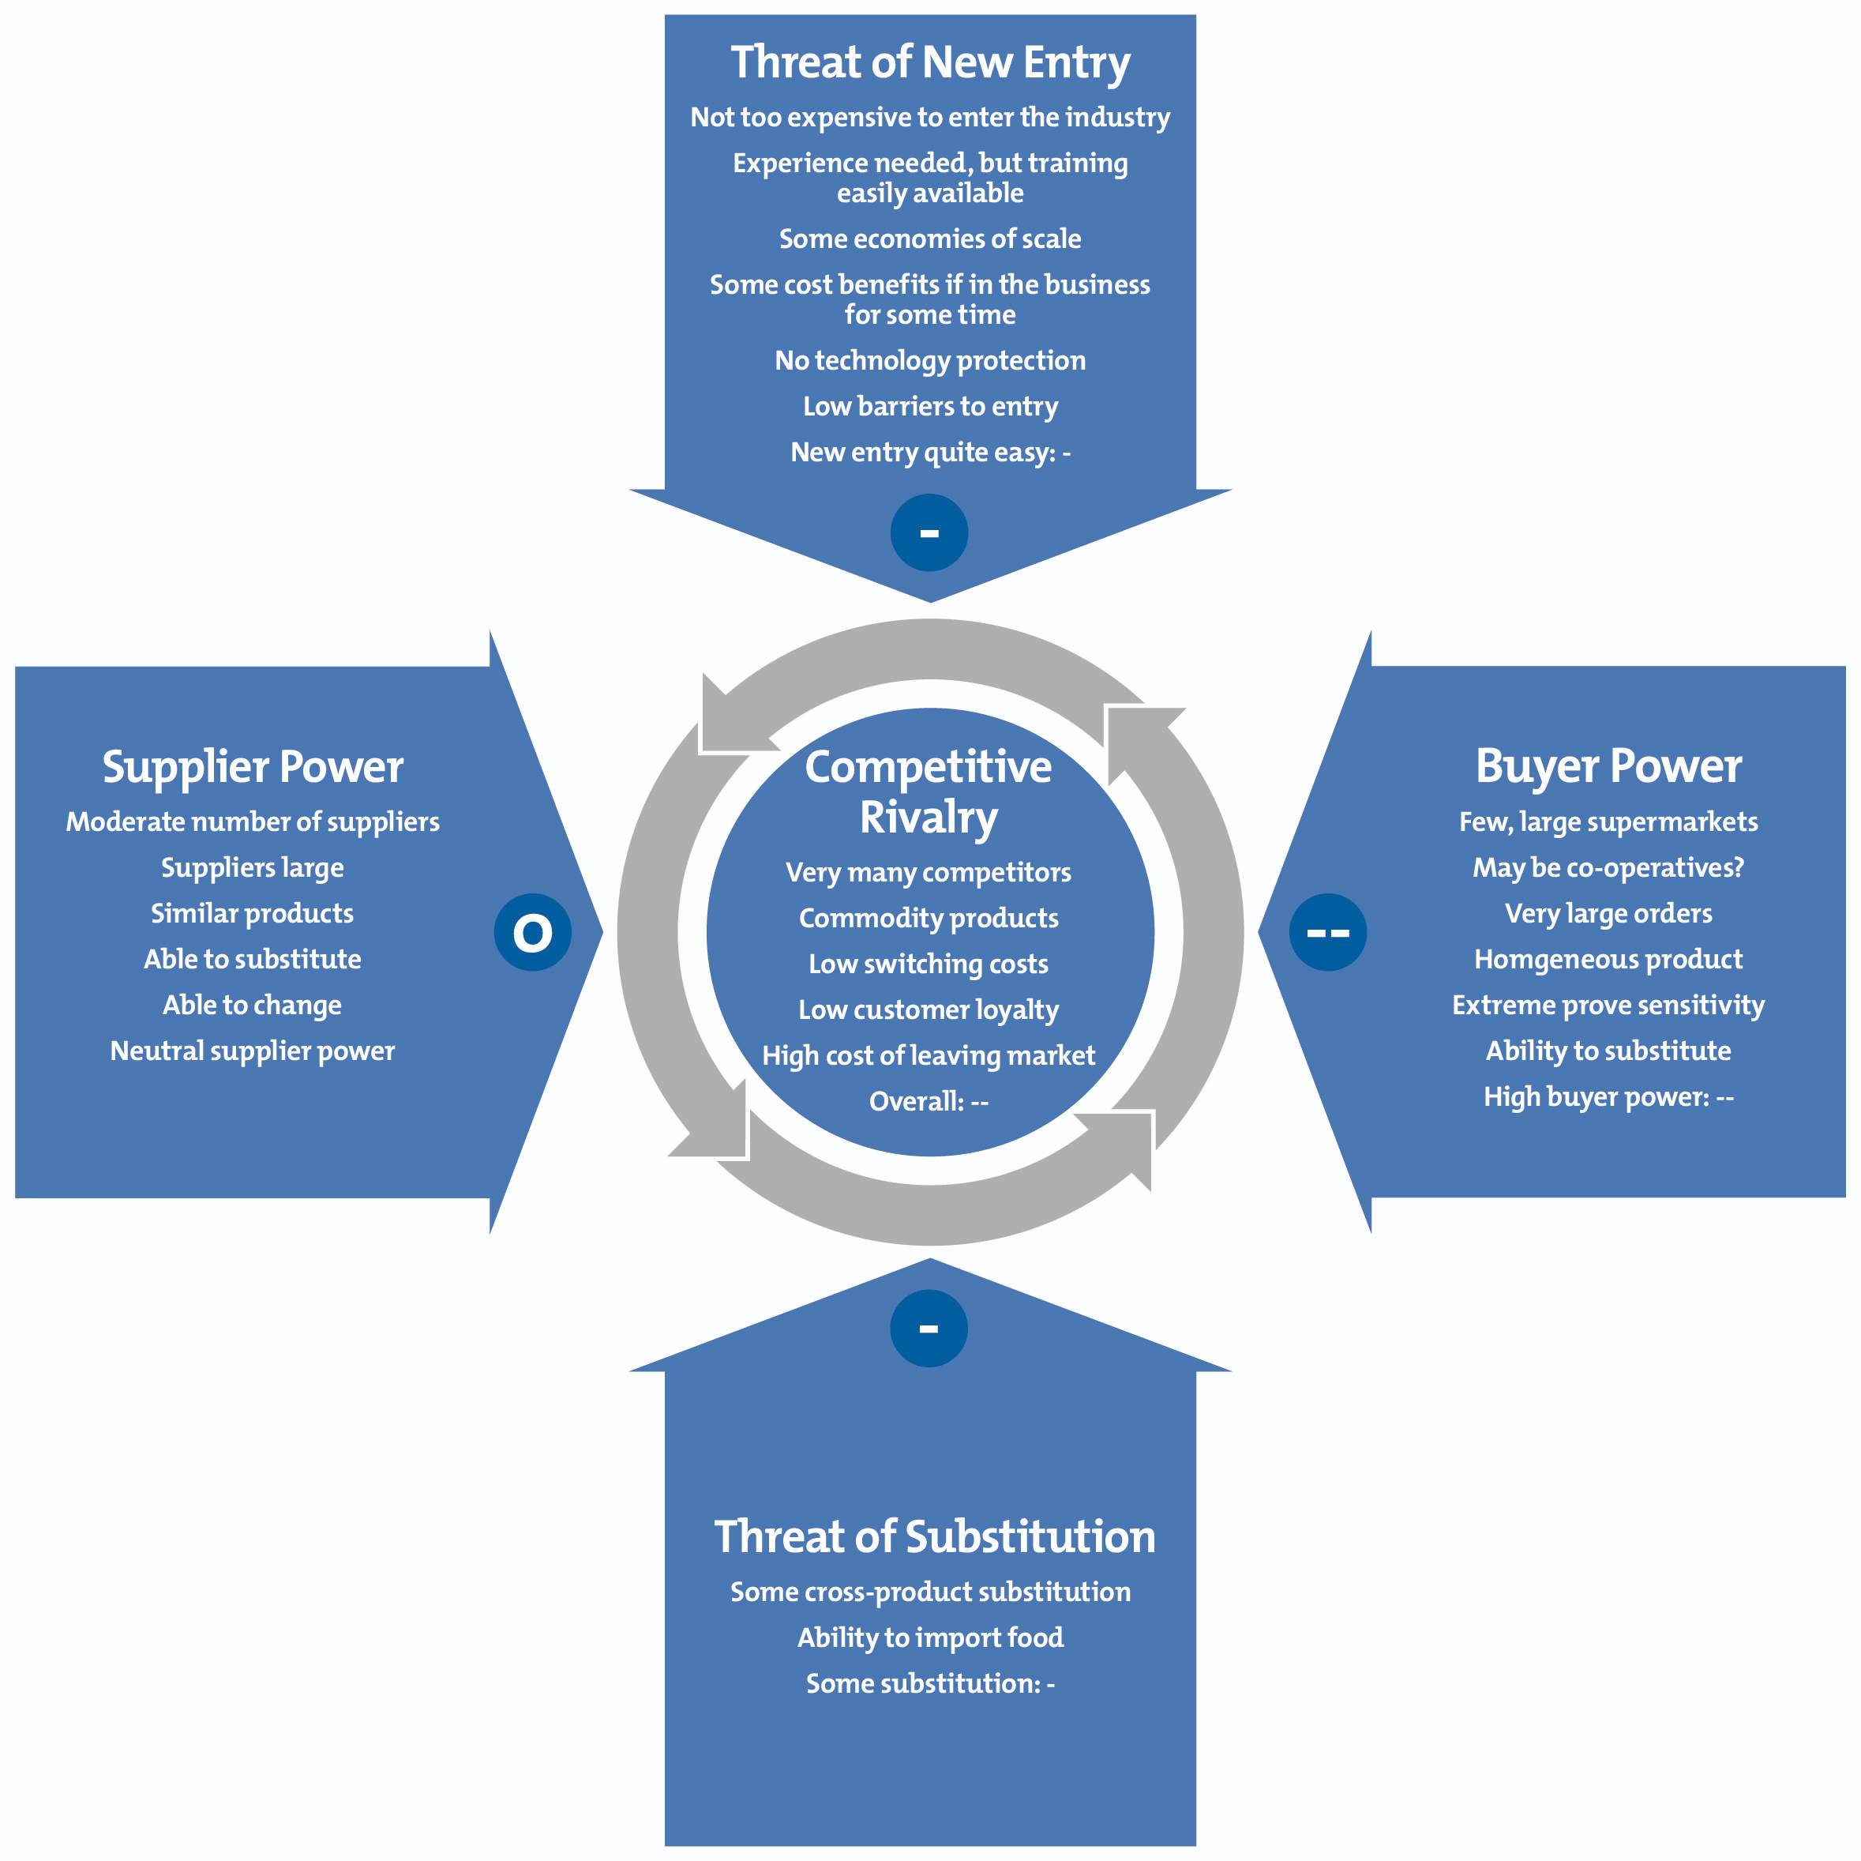
Porter’s Five Forces
Abhijit Valiathan

Slide 13
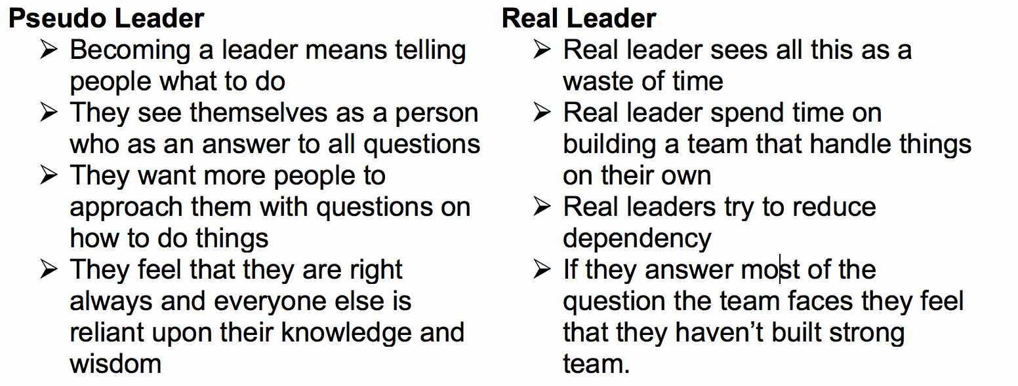
#1 Mistakes most leaders make
Most Leaders confuse control with delegation
Sheshadri Talla

Slide 14
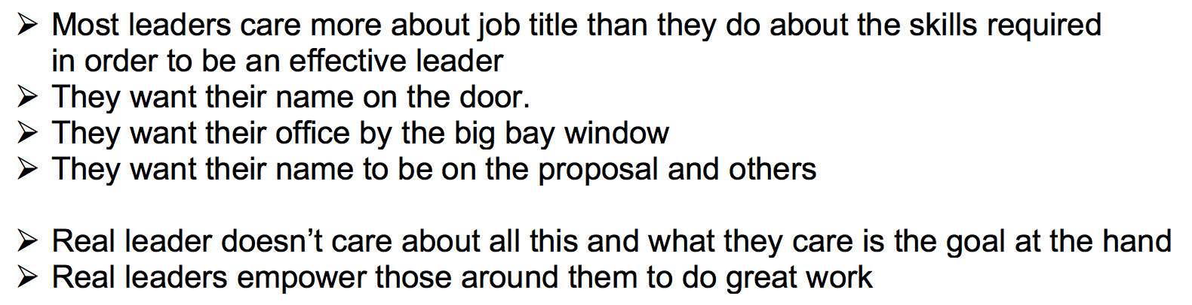
#2 Mistakes most leaders make
Most Leaders Care More About The Title Than The Job Requirements
Sheshadri Talla

Slide 15
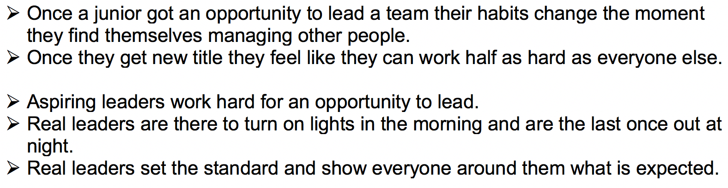
#3 Mistakes most leaders make
Most leaders work less than everyone else and expect more than anyone else
Sheshadri Talla

Slide 16
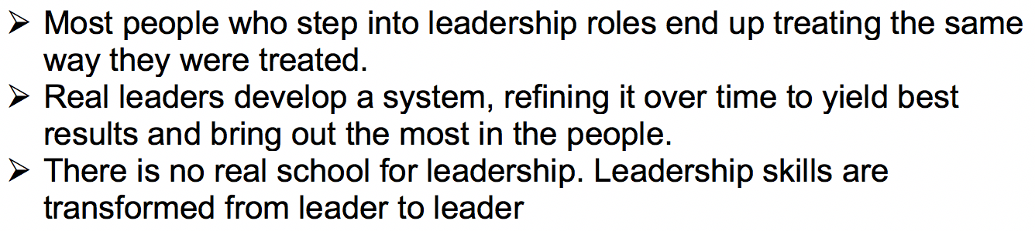
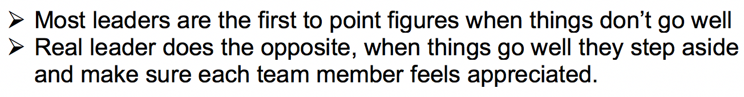
#4 Mistakes most leaders make
Most leaders treat others the way they were treated
Most Leaders Want To Take Credit For The Wins, And Shift Blame For The Losses
Sheshadri Talla

Slide 17
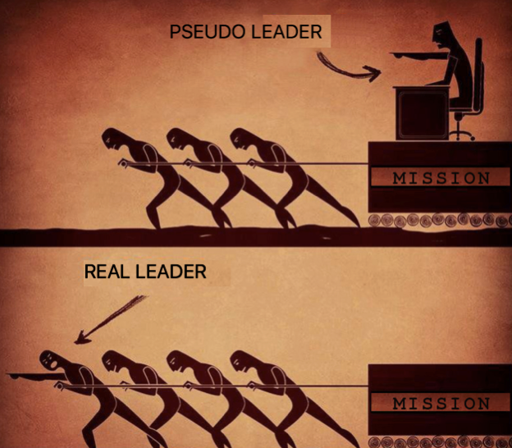
Conclusion
Sheshadri Talla

Slide 18
Questions for the discussion.

Slide 19
Questions?
Q: In the assessment of an organization, What are the areas where development or improvement is needed?

Slide 20
Questions?
Q: If you have worked in a organization before, Do you believe in the mission Statement of the organization ? Do you feel your work is contributing to the advancement of the mission?

Slide 21
Questions?
Q: What is your perception and opinion of the brand of the organization you have worked for? The organization’s visibility? Are you familiar with all of the programs run by the organization for Assessment?

Slide 22
Questions?
Q: Are you aware of your organization’s competitors and collaborators? What are their agendas and priorities? How well do you perform relative to your competitors? What do your competitors think of the quality and quantity of your services?

Slide 23
References:
https://static1.squarespace.com/static/57ac6add15d5db281ea867f5/t/57d80b90ebbd1a24f28a15d4/1473776529105/Internal+and+External+Assessment.pdf
https://www.shell-livewire.org/business-library/675/swot-analysis-strengths-weaknesses-opportunities-and-threats
https://books.google.com/books?id=-xIWlA_UHnAC&pg=PA43&lpg=PA43&dq=Scanning:+It+includes+general+surveillance+of+all+environment&source=bl&ots=AsEa4Luli5&sig=8fHB-_YDFv_LyBcHTho43zh6ni8&hl=en&sa=X&ved=0ahUKEwjYgs3p7tbZAhXPxVkKHdx4C7wQ6AEILDAA
http://smallbusiness.chron.com/internal-analysis-important-80513.html
https://www.mindtools.com/pages/article/newSTR_91.htm
https://www.forbes.com/sites/chrismyers/2018/01/01/the-three-biggest-leadership-mistakes-i-made-in-2017-and-how-ill-fix-them-in-2018/#3834e95c3609

Slide 24
Thank You!

